Slide 1
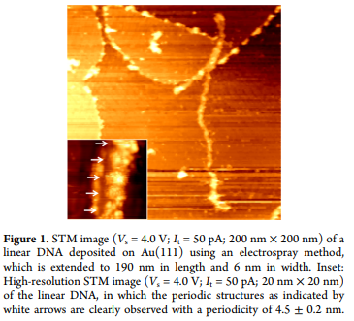
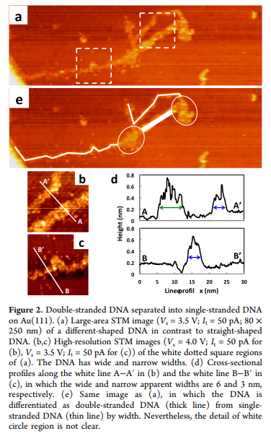

Structural Modification of DNA Studied by Scanning Tunneling Microscopy
Objective
Visualize structural variants on DNA deposited on AU(111), such as cross and T-shaped formations, with low temperature scanning tunneling microscope.
Sample Description
Eight kinds of DNA fragments with different number of base pairs were consider for this study, the concentration of DNA was 0.5 μg/μL, The DNA solution was diluted 10 times in water and volatile acetonitrile.
Process
Molecular deposition was performed using the electrospray deposition system. the sample was subsequently transferred to the low-temperature STM stage without thermal annealing, in a constant current mode of 50 pA at 78 K under UHV condition
Results
Various shapes of DNA were identified by STM, in the UHV condition, like partially formed single-stranded DNA, T-shaped DNA, and their mixtures, this indicates that about half of the adsorbed DNAs have changed to structures different from the double helix structure of DNA

